Slide 1

Bioinformatic approaches to regulatory genomics and epigenomics
376-​1347-00L - 2022 | week 06
Pierre-Luc Germain

Slide 2
Plan
Quick things (see slack) :
Polls
New channel for discuss project ideas
New packages to install
Debriefing on last week’s assignment
Overview of transcription factors and their binding specificity
Motifs and related analysis

Slide 3
A few extra questions raised
Where do the files we export get saved? Can you move/copy files in your folders for them to be accessible by a new Markdown document?
Why do we have to save the things from ENCODE with .gz in the end and not just e.g. .bed?
What exactly are seqlevels?
Why are overlaps asymmetric?

Slide 4
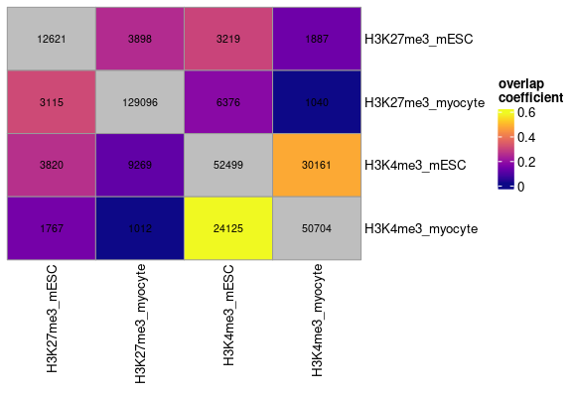
Why are overlaps asymmetric?

Slide 5
Why are overlaps asymmetric?
Set A:
Set B:
How many elements of A overlap elements of B? → 2/3
How many elements of B overlap elements of A? → 1/3

Slide 6
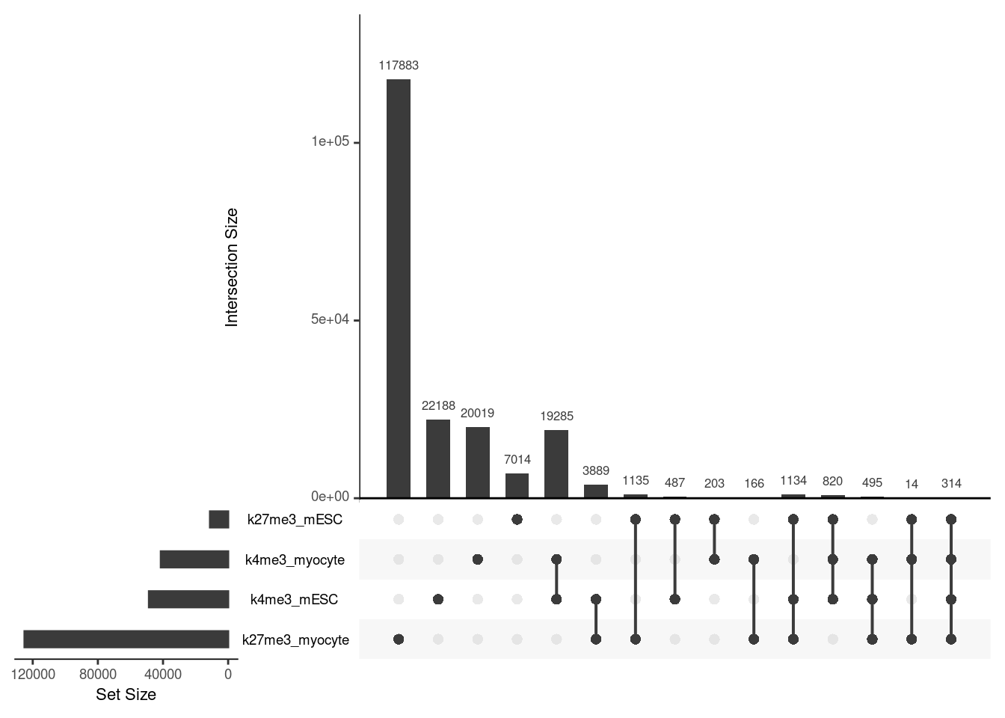
Last week’s assignment
Virtually all of you
gave something like this as an answer:
Question: How many of the mESC bivalent domains are, in this differentiated cell type, overlapping either mark (K4me3/K27me3) or their combination?
Expected form of the answer: Of the XXX mESC bivalent domains, XX also have both marks in myocytes, while XX are H3K4me3 and XX are H3K27me3.

Slide 7
Intersection & overlap:
The example of bivalent domains
H3K4me3:
H3K27me3:
method one (overlapsAny): find the H3K4me3 peaks that overlap a H3K27me3 domain
method two (intersect): find the regions that are covered by both H3K4me3 and H3K27me3

Slide 8
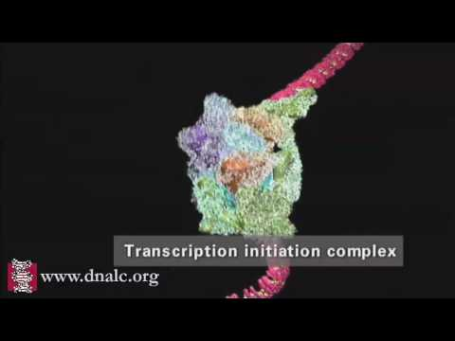
https://youtu.be/SMtWvDbfHLo
( See also https://youtu.be/WW9lIYM_FC0 )

Slide 9
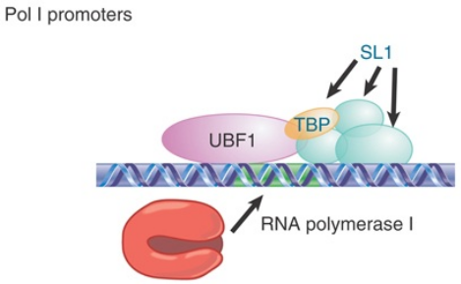
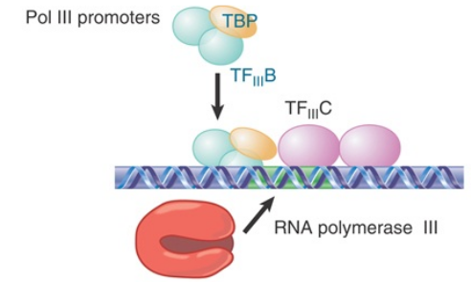
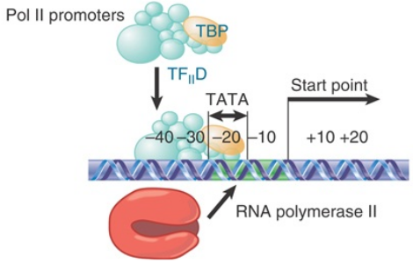
rRNA
tRNA
Most RNAs
(Adapted from Krebs, Goldstein and Kilpatrick, Genes XII, 2018)

Slide 10
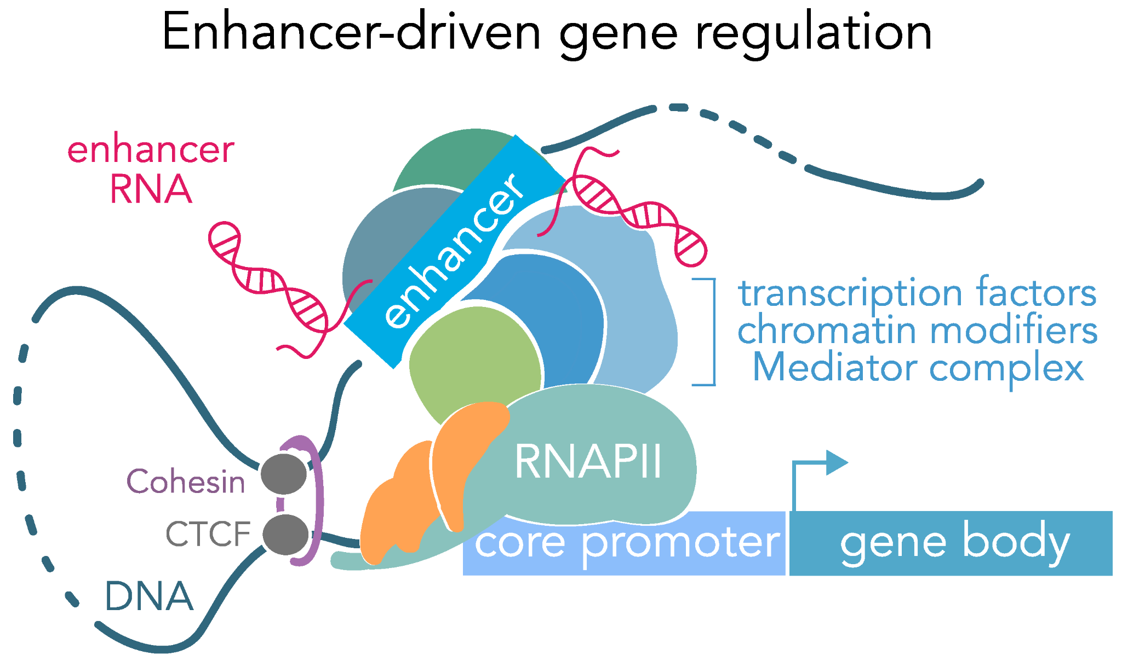
Additional regulatory elements
(Carullo and Day, Genes 2019)

Slide 11
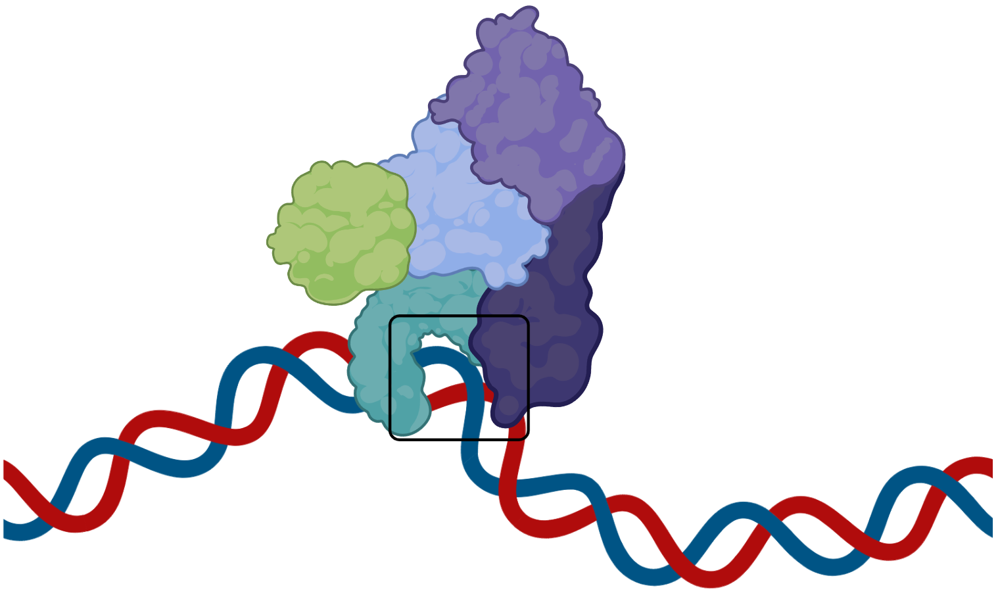
What is a transcription factor?
Not transcription factors
Proteins capable of both:
Binding DNA in a sequence-specific manner
Regulating transcription
(Lambert et al., Cell 2018)
Sequence-specific DNA binding
(biorender)
co-regulators /
co-factors
Transcription factors
Transcription regulators

Slide 12
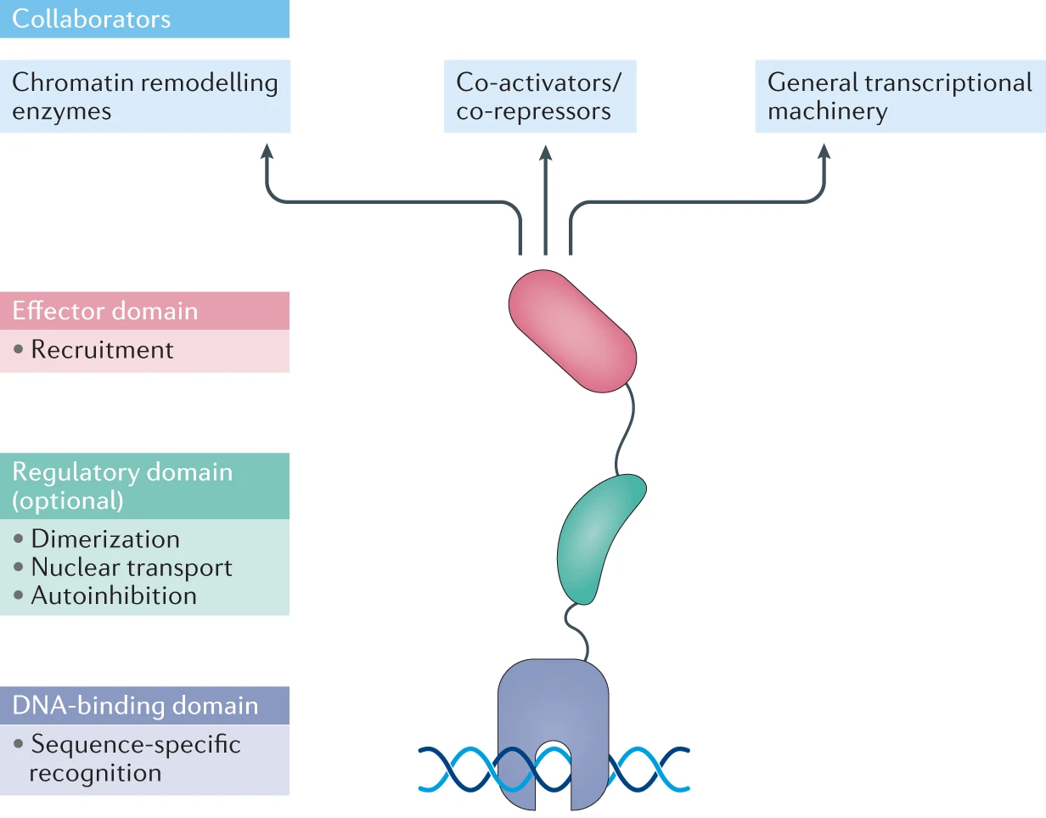
Anatomy
of a transcription
factor (TF)
(Henley & Koehler, NRDD 2021)

Slide 13
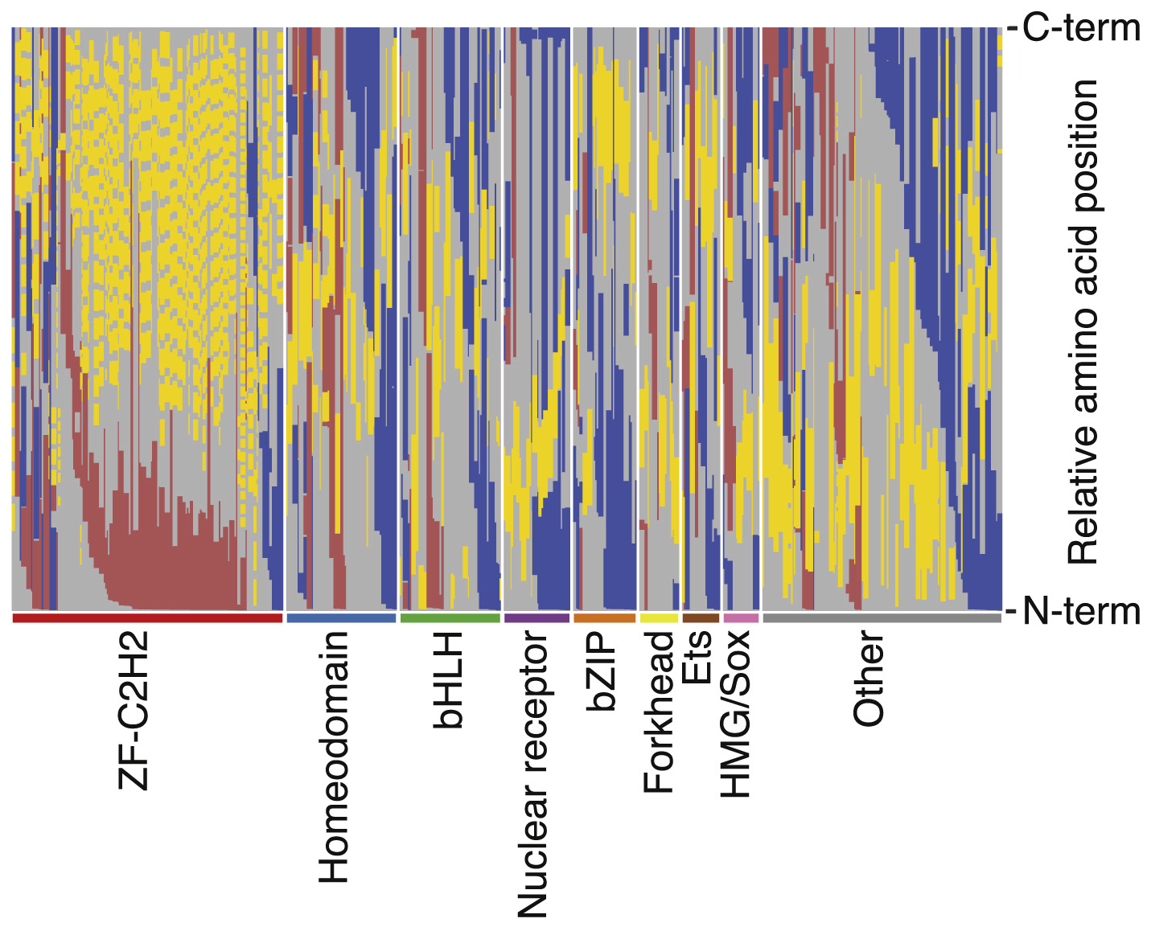
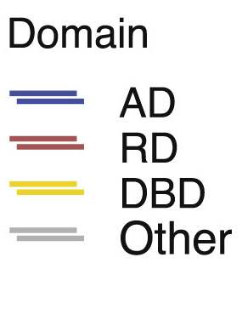
While most TF have either an activating (AD) or repressive (RD) domain, some have both
(Adapted from
Soto et al., Molecular Cell 2021)

Slide 14
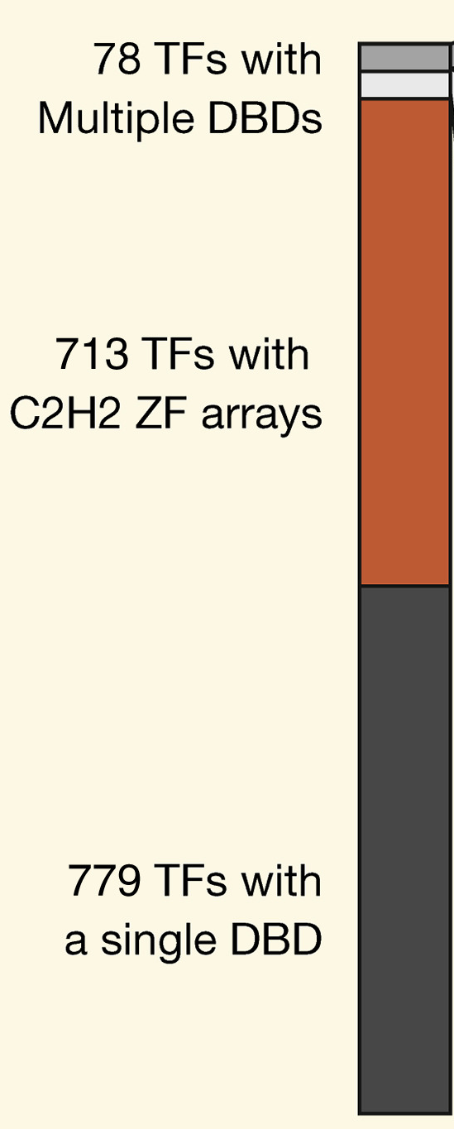
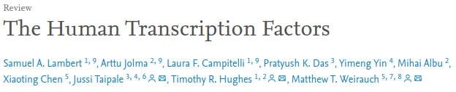
(Cell 2018)
Proteins capable of both:
Binding DNA in a sequence-specific manner
Regulating transcription
According to their census, humans have 1570 transcription factors

Slide 15
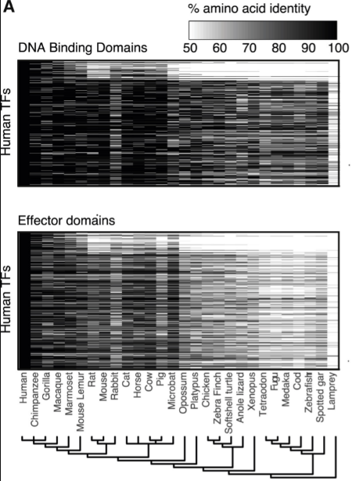
Transcription factors are highly conserved
DNA binding domains show much higher conservation than effector domains
(Soto et al.,
Molecular Cell 2021)

Slide 16
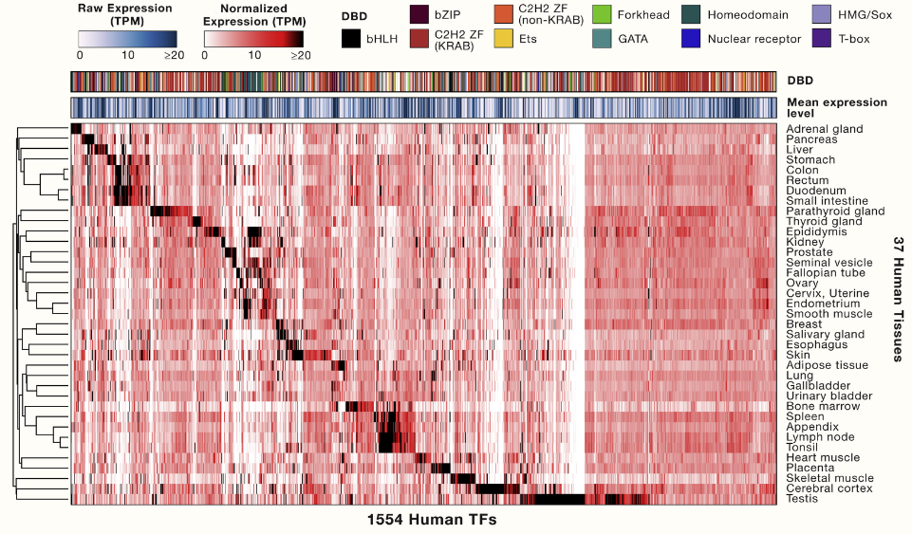
Homeodomain
TFs tend to be tissue-specific (82%)
ZFs (>80%) tend not to be
tissue-specific
(Lambert et al., Cell 2018)

Slide 17
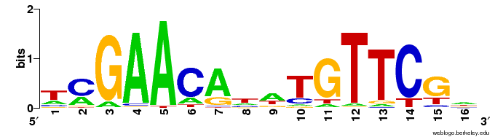
Sequence-specificity
E.g. The LexA bacterial TF recognizes the consensus sequence
5'-GAACAnnTGTTC-3'
-log2(p-value)

Slide 18
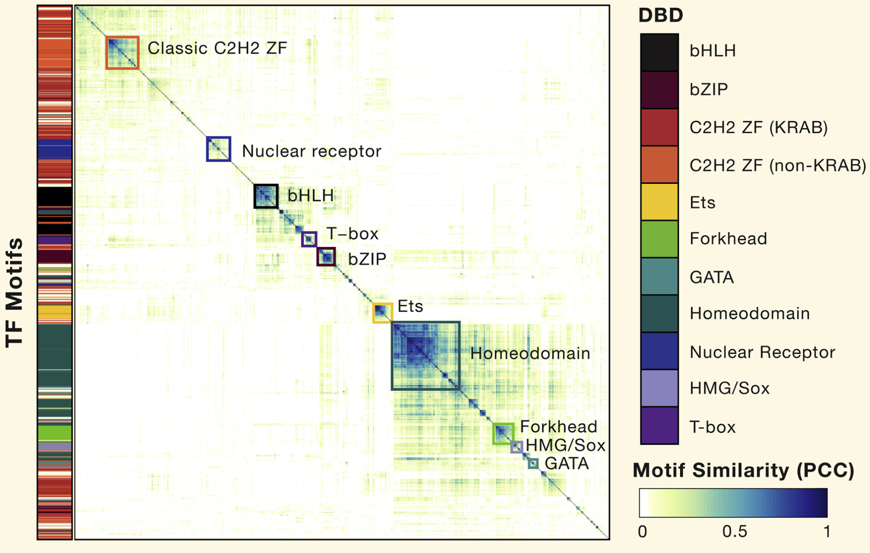
(Lambert et al.,
Cell 2018)

Slide 19
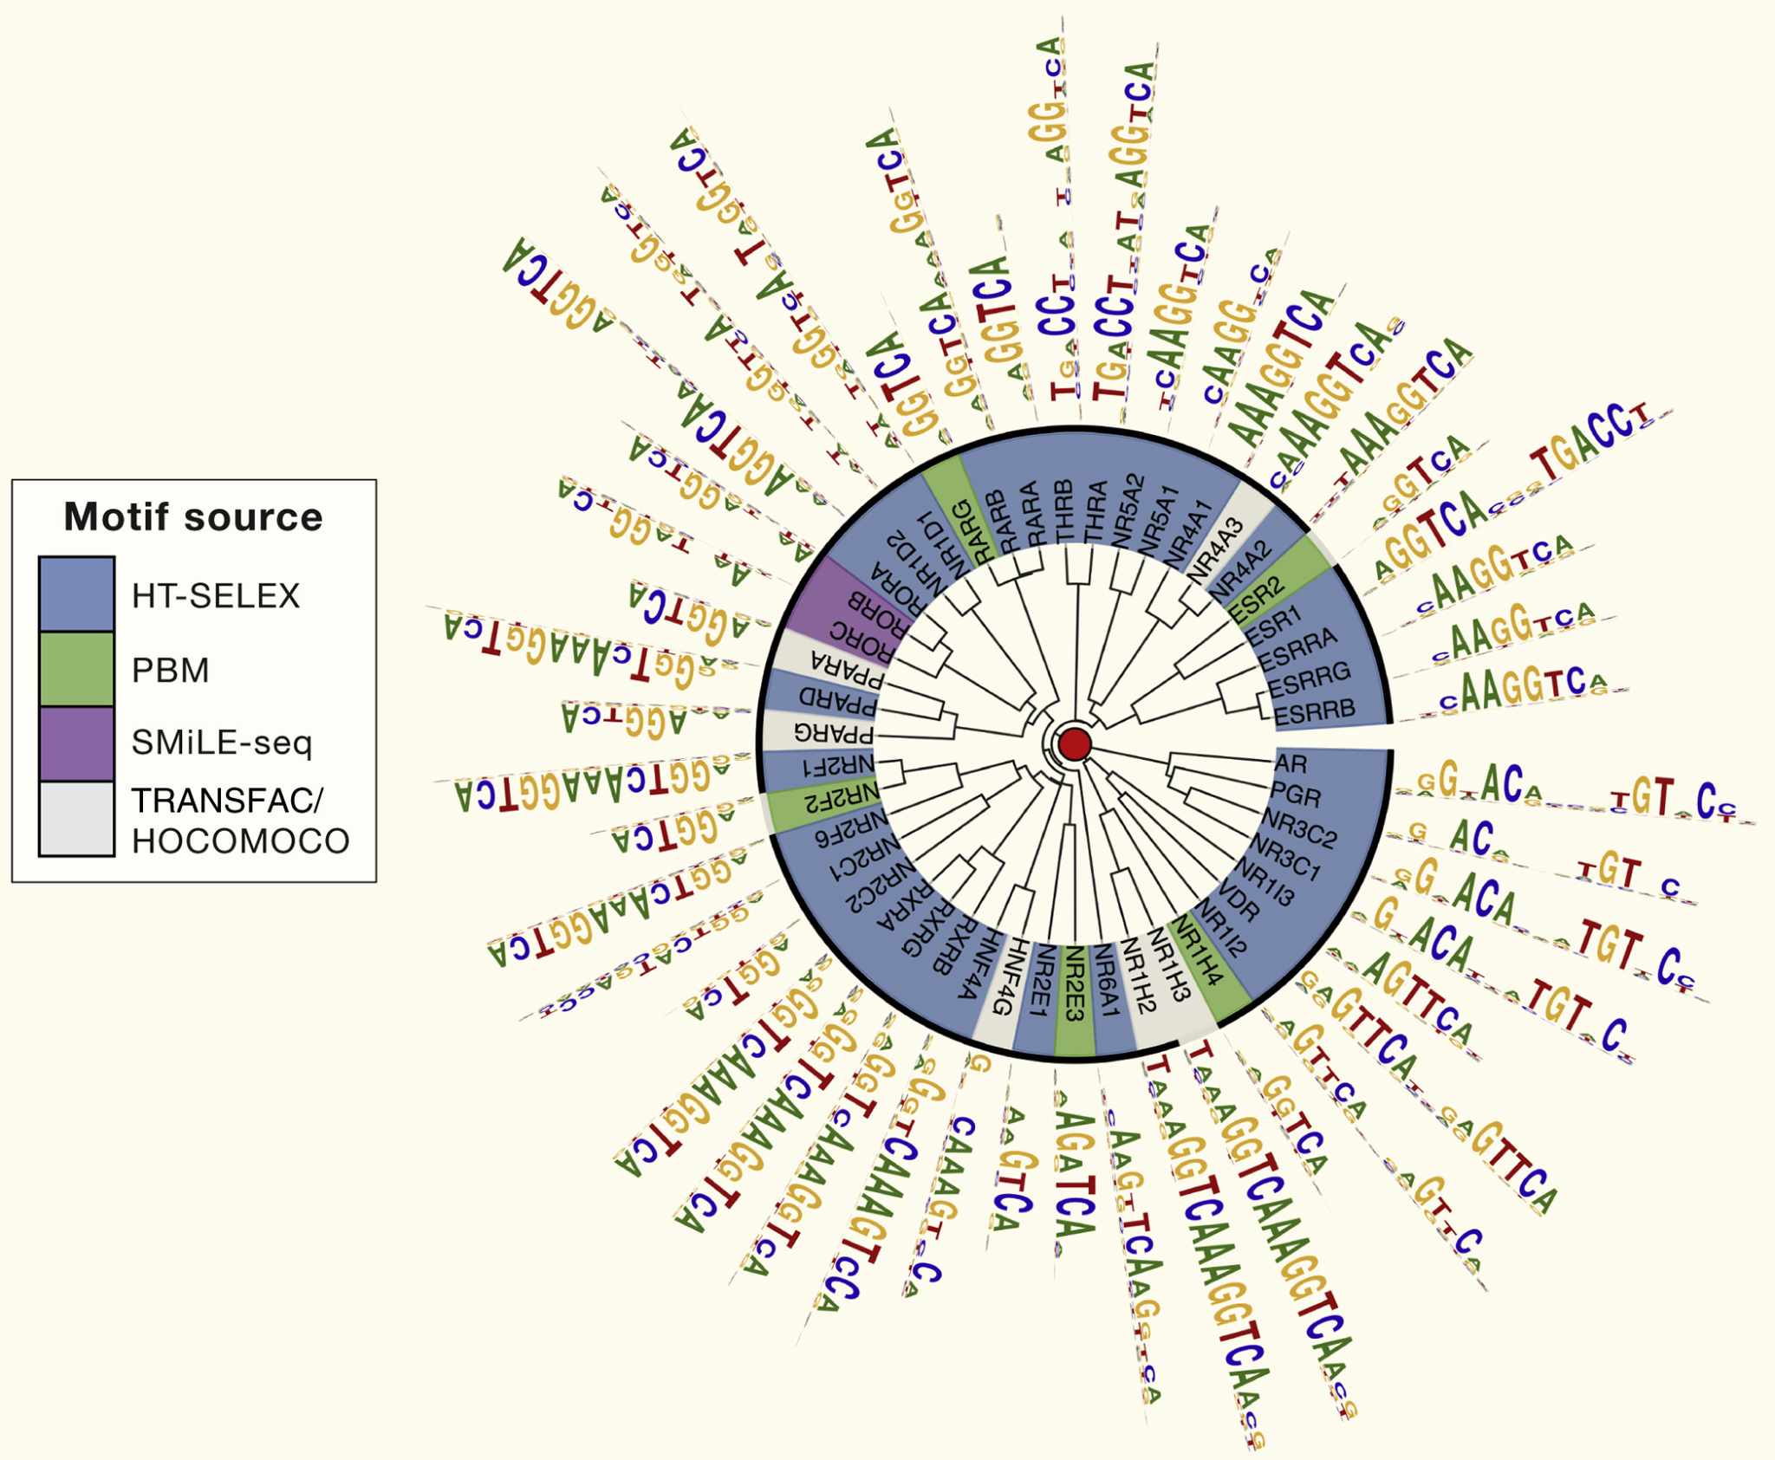
An example of TF motif degeneracy:
Nuclear hormone receptors
(Lambert et al., Cell 2018)

Slide 20
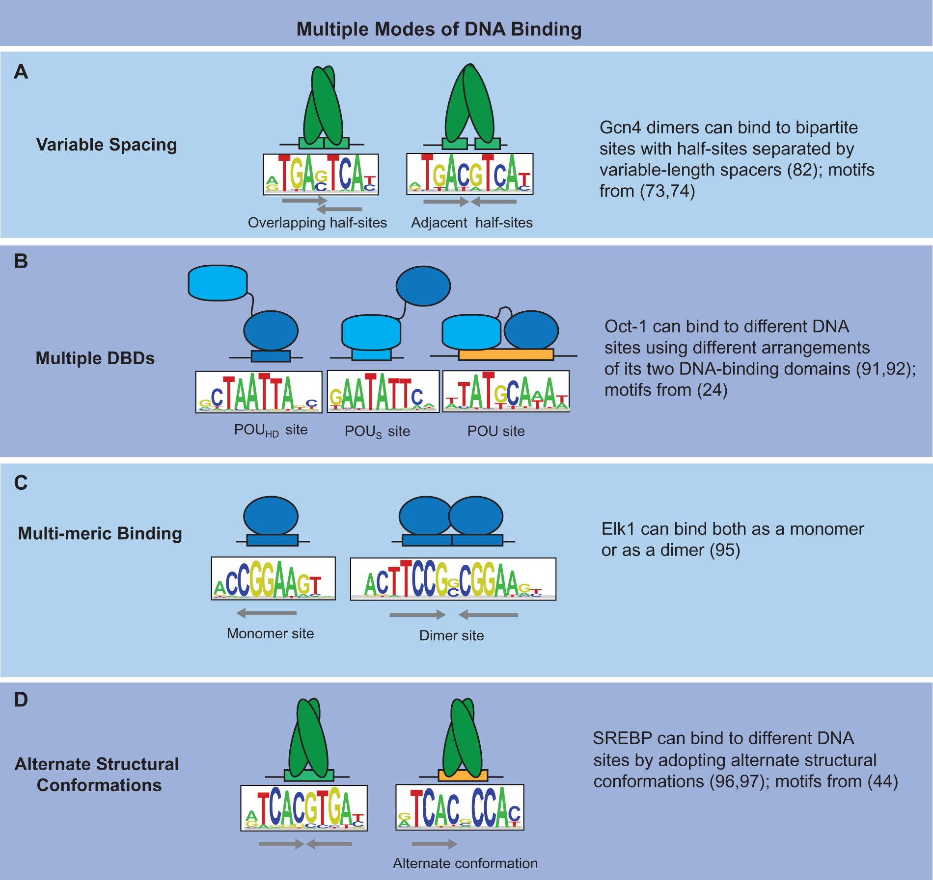
Variations in
DNA binding
specificity
(Siggers and Gordân, NAR 2014)

Slide 21
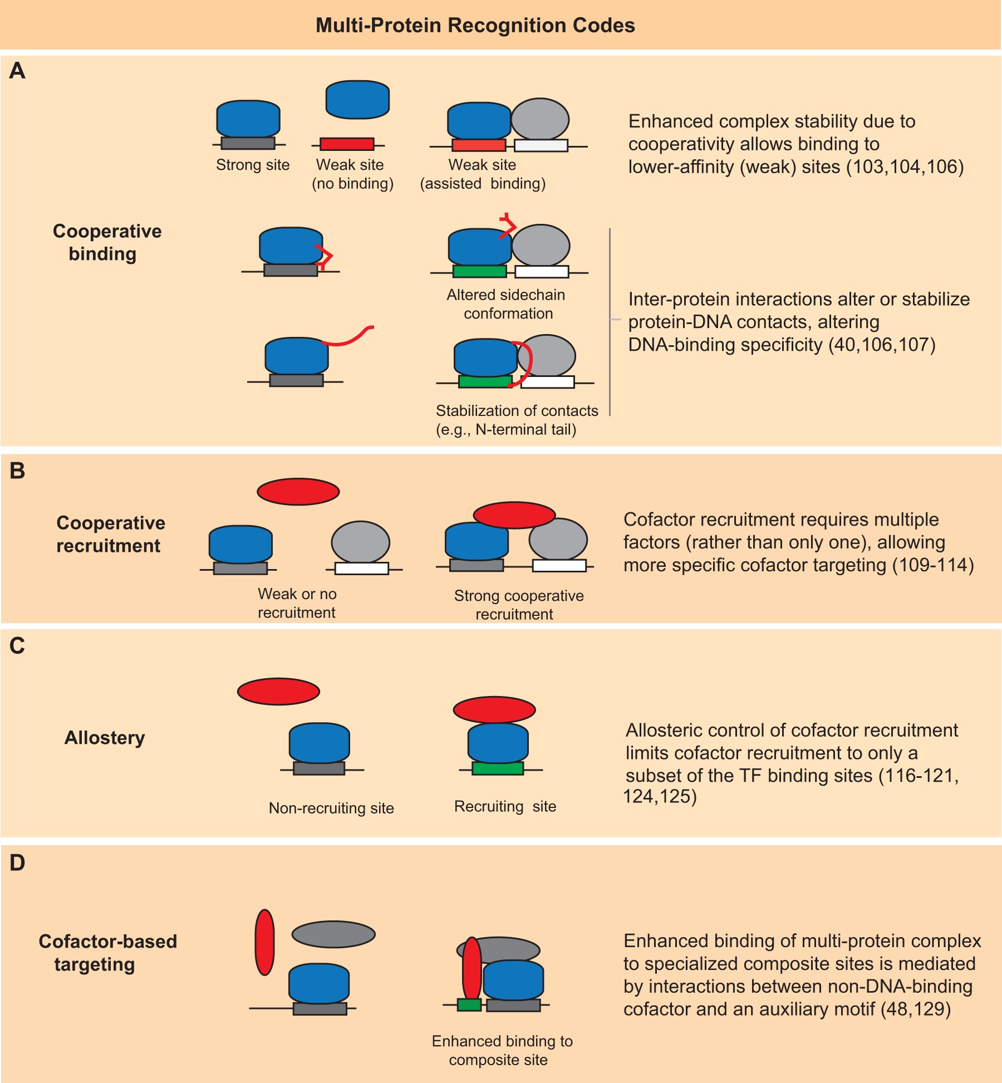
Cooperative binding
Highly combinatorial
binding of TFs
(Siggers and Gordân, NAR 2014)

Slide 22
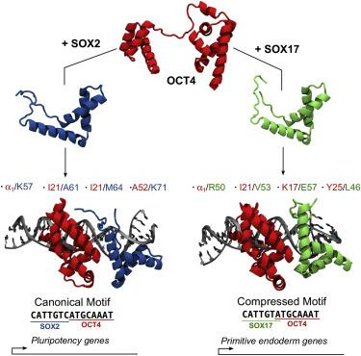
Two examples of Cooperative binding
OCT4 (POU5f1) binding
upon differentiation
(Merino et al., Structure 2014)

Slide 23
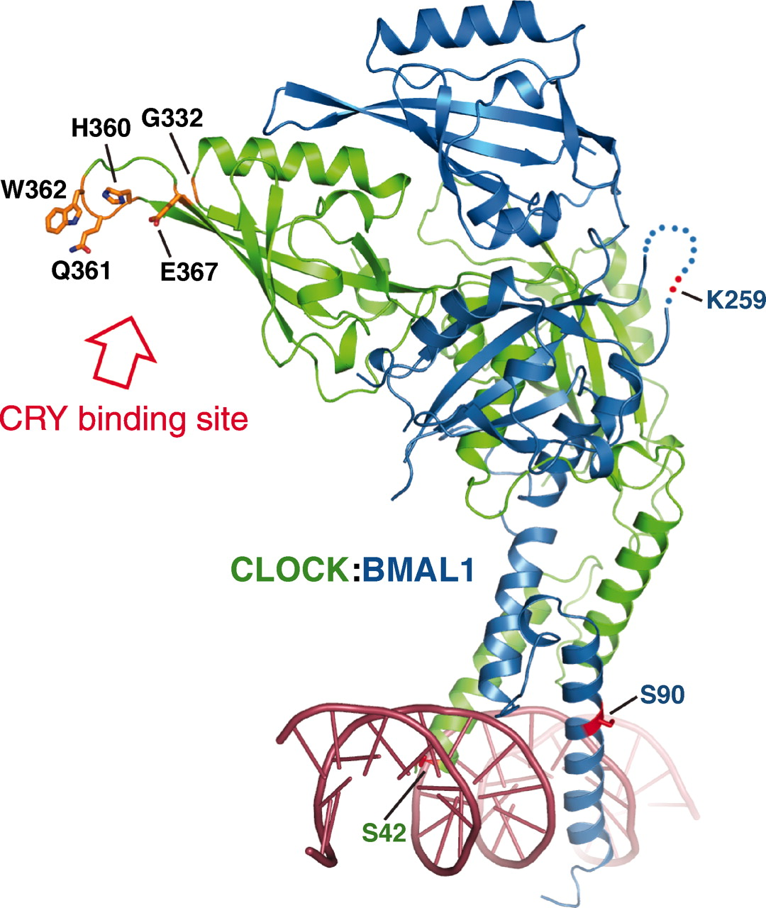
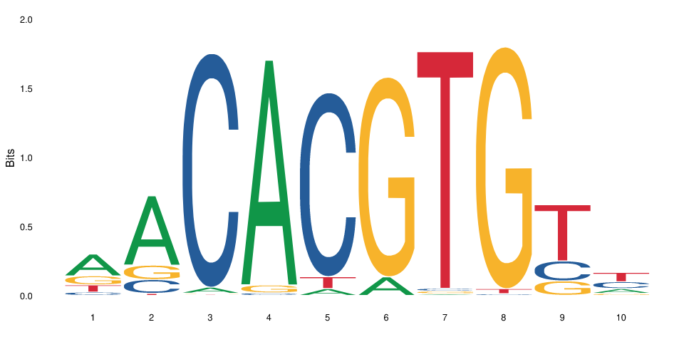
Clock-Bmal-Cry during
circadian rythm
(Huang et al., 2012)

Slide 24
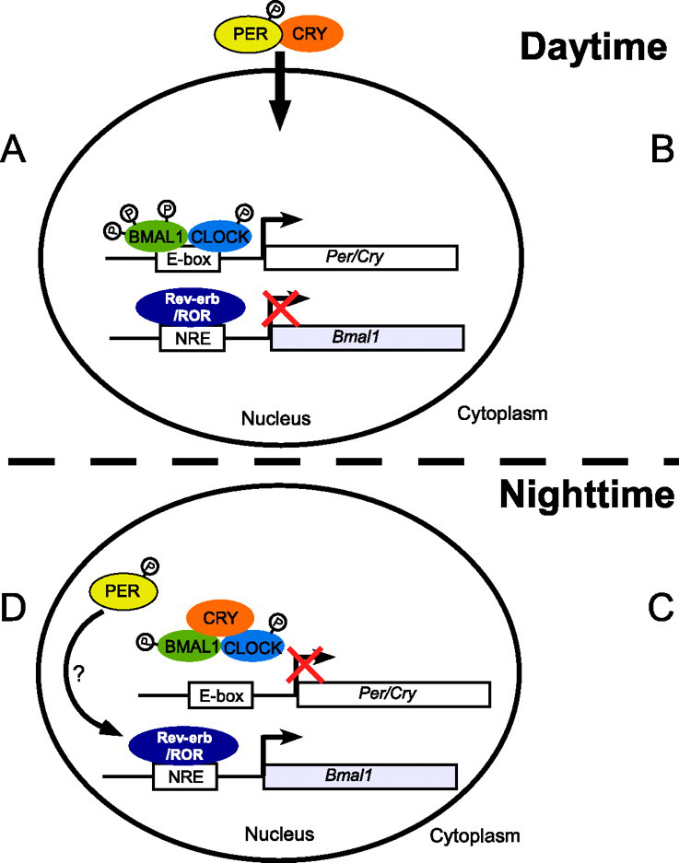
(Huang et al., 2012)
(Adapted from Ye et al., JBC 2011)

Slide 25
Motif analysis
Motif discovery aims at finding new motifs that are enriched in a set of sequences (e.g. peaks) versus a background
Example method: meme (Meme suite)
Bioconductor method: rGADEM package (see also the memes package)
Motif enrichment analysis aims at finding known motifs that are enriched in a set of sequences (e.g. peaks) versus a background
Example method: AME (Meme suite)
Bioconductor method: PWMEnrich package
Motif scanning aims at finding the occurrences of known motifs in a set of sequences (methodologically fairly simple – which method doesn’t matter much)
Example method: fimo (Meme suite)
Bioconductor method: searchSeq function of the TFBSTools package

Slide 26
Assignment
Choose a transcription factor, e.g. CREB1, REST, GATA5, EGR1, GCR (or any of your choice that has a motif and available ChIPseq data)
Download the (e.g. Mouse) peaks for that factor (whatever cell type)
Identify the instances of the factor’s motif
Answer the following questions:
Of all the peaks, what proportion contains a motif for the factor?
Expected form of an answer: of the XX peaks, XX (XX%) contain a motif
Of all instances of that motif in the genome, what proportion is bound by the factor (i.e. has a peak)?
Expected form of an answer: of the XX motif instances, XX (XX%) overlap a peak
Don’t forget to render your markdown and push it as assignment.html !

